Slide 1
Return Path Optimization
Kevin Seaner
Aurora Networks
kseaner@aurora.com

Slide 2
Return Path Familiarization & Node Return Laser Setup
CATV Network Overview
Coaxial Network (RF Distribution)
  Unity Gain
  Input Levels to Actives
Fiber Network (Laser/Node/Receiver)
  NPR
  Return Laser Setup
Headend Distribution Network
  Return Receiver Setup
  Combining Losses
The X Level
Network Troubleshooting

Slide 3
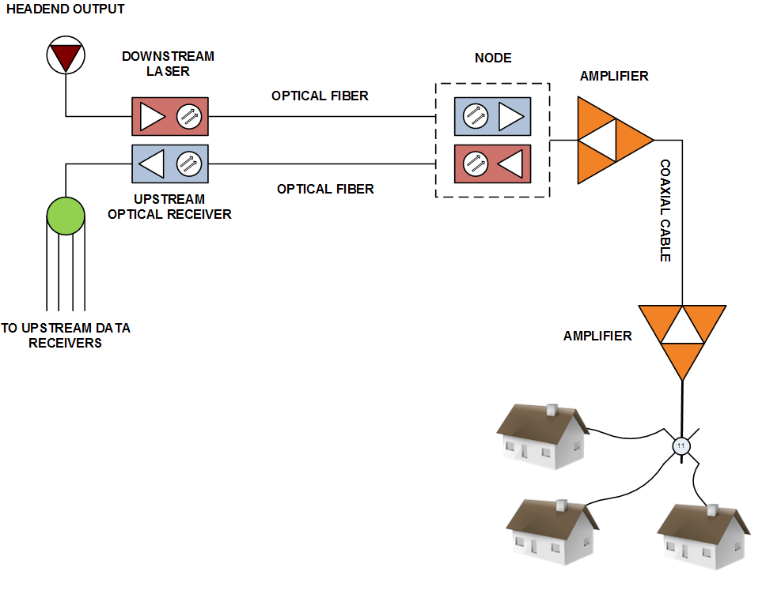
Typical Two-Way HFC CATV System?
Downstream (Forward)
Upstream (Return)
Network appears to be two one-way systems
Notes:
This diagram shows the fundamental parts of a two-way CATV system. In the 50-750 MHz downstream path, RF signals from the headend may be transmitted to strategically located nodes via fiber optic cables. At each node, the optical signals are converted back to RF, and distributed via coaxial cable and amplifiers throughout the service area. Subscriber drop cables are connected to the coaxial network at taps (not shown) spaced periodically along the feeder cable.
Upstream signals from each subscriber are transmitted in the 5-42 MHz spectrum through the same coaxial cables and amplifiers used for downstream operation. These upstream signals are amplified as necessary in circuits located in the amplifier housings (internal diplex filters separate the downstream and upstream signals, and route them to their respective amplifier modules or circuits).
At the node, the upstream signals are converted to light and transmitted via fiber to the headend. The outputs of the headend receivers are connected to the respective upstream equipment.

Slide 4
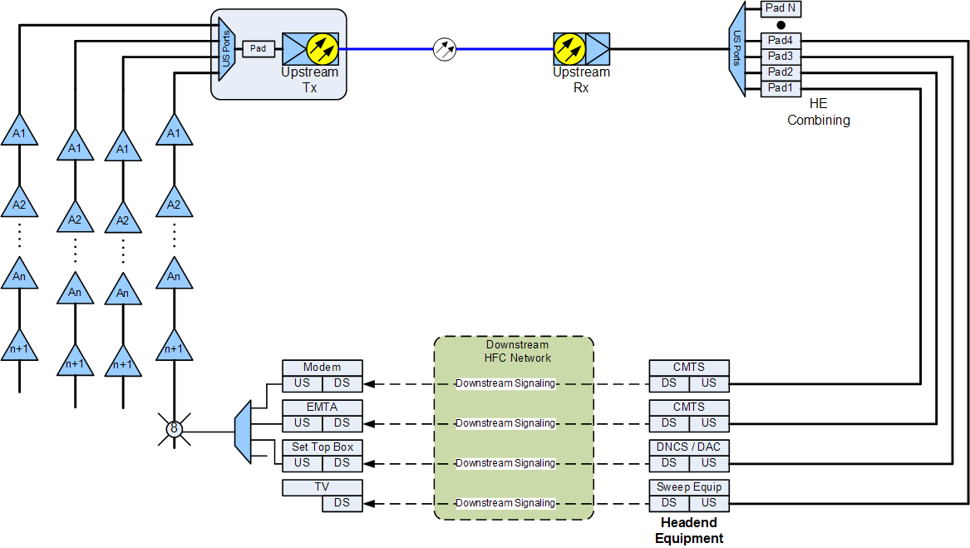
With DOCSIS deployed in our Networks the system looks and functions more like a loop!
DOCSIS ALC
Changes in the
INPUT to the CMTS
cause changes to
be made to the
output levels of the
modems

Slide 5
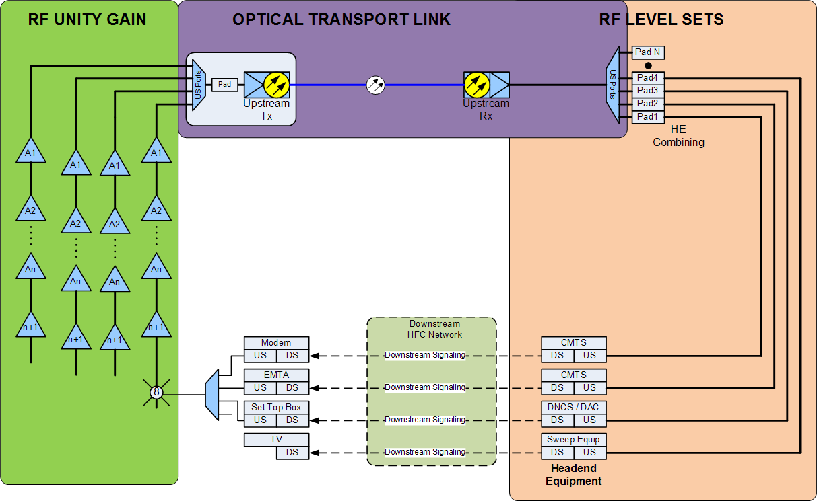
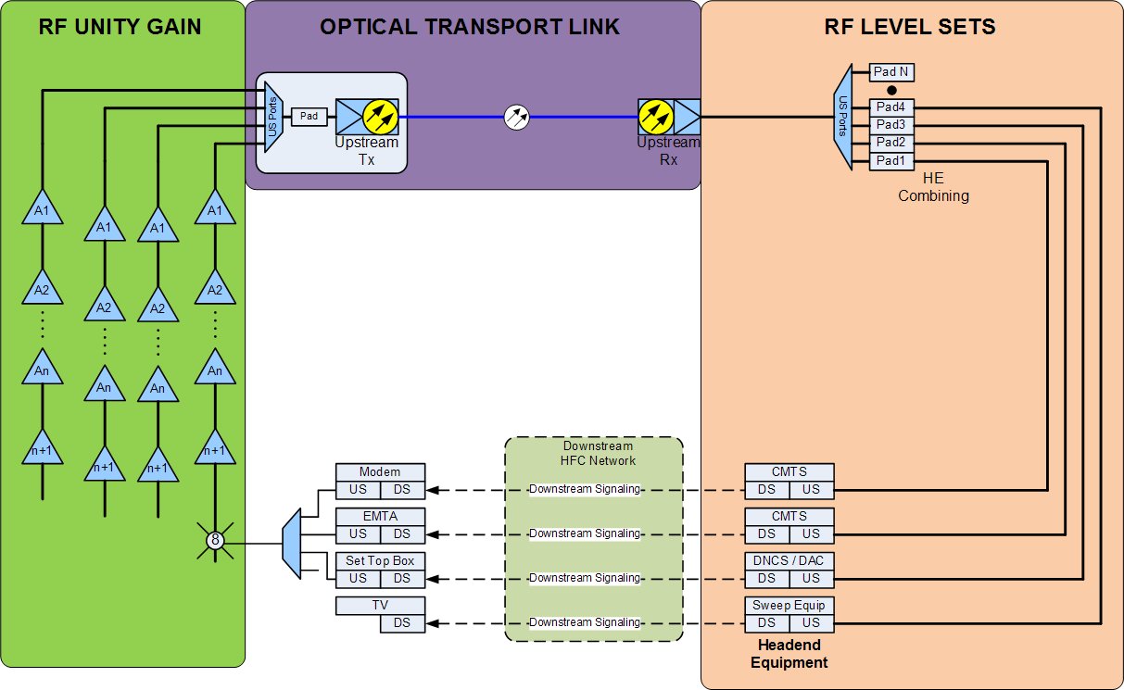
Divide and Conquer the Return Path!

Slide 6
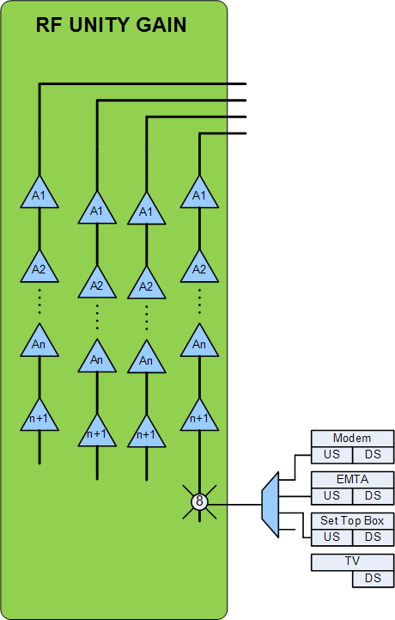
RF Network
Forward Path
  Output of Node RX to TV, STB, or Modem
Return Path
  Output of Set Top or Modem to Input of Node
Unity Gain
  Forward Path
  Return Path

Slide 7
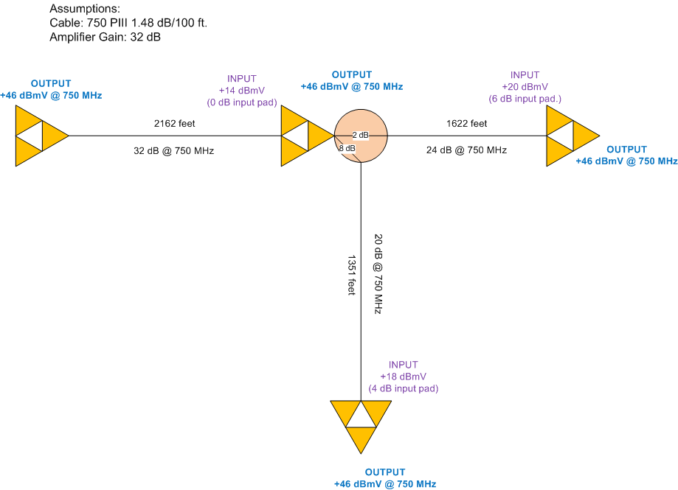
Forward Path Unity Gain
Unity gain in the downstream path exists when the amplifier’s station gain equals the loss of the cable and passives before it.
In this example, the gain of each downstream amplifier is 32 dB. The 750 MHz losses preceding each amplifier should be 32 dB as well.
  For example, the 22 dB loss between the first and second amplifier is all due to the cable itself, so the second amplifier has a 0 dB input attenuator. Given the +14 dBmV input and +46 dBmV output, you can see the amplifier’s 32 dB station gain equals the loss of the cable preceding it.
The third amplifier (far right) is fed by a span that has 24 dB of loss in the cable and another 2 dB of passive loss in the directional coupler, for a total loss of 26 dB. In order for the total loss to equal the amplifier’s 32 dB of gain, it is necessary to install a 6 dB input attenuator at the third amplifier.
In the downstream plant, the unity gain reference point is the amplifier output.

Slide 8
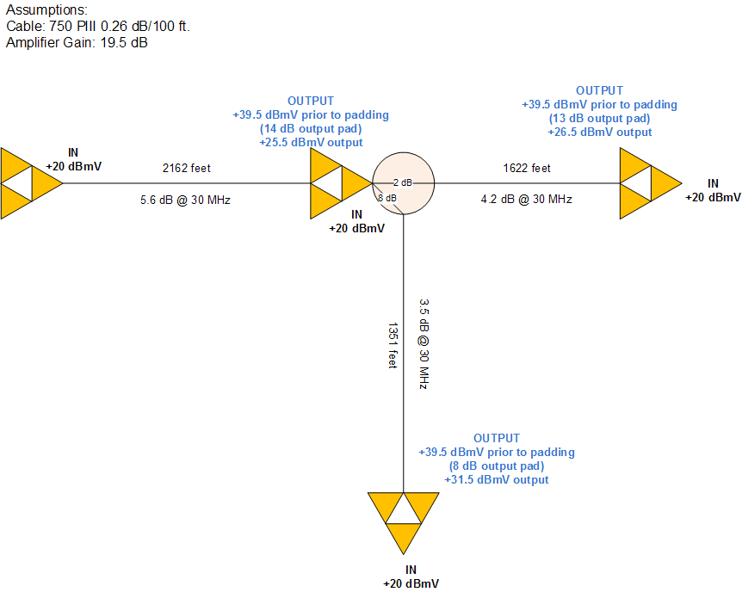
Reverse Path Unity Gain
Why should the inputs to each active be +20 dBmV??
  SYSTEM /DESIGN SPECIFIC
  Does not matter on Manufacturer’s equipment!
Unity gain in the upstream path exists when the amplifier’s station gain equals the loss of the cable and passives upstream from that location.
In this example, the gain of each reverse amplifier is 19.5 dB. The 30 MHz losses following each amplifier should be approximately 19.5 dB as well.
In the upstream plant, the unity gain reference point is the amplifier input.
Set by REVERSE SWEEP!
Notes:
Unity gain in the upstream path exists when the amplifier’s station gain equals the loss of the cable and passives upstream from that location. In this example, the gain of each reverse amplifier is 15 dB. The 30 MHz losses following each amplifier are 15 dB as well.
For example, the 4 dB loss between the first and second amplifier is all due to the cable itself, so the second amplifier has an 11 dB output attenuator. The amplifier input is +20 dBmV, making the reverse amplifier module output +35 dBmV. In order to obtain unity gain and the correct input at the first upstream amplifier location, an 11 dB output attenuator is required at the second amplifier’s reverse output so that the total loss equals the gain of the amplifier.
The third amplifier (far right) feeds a span that has 3 dB of loss in the cable and another 2 dB of passive loss in the directional coupler, for a total loss of 5 dB. In order for the total loss to equal the amplifier’s 15 dB of gain, it is necessary to install a 10 dB output attenuator at the third amplifier.
In the upstream plant, the unity gain reference point is the amplifier input.

Slide 9
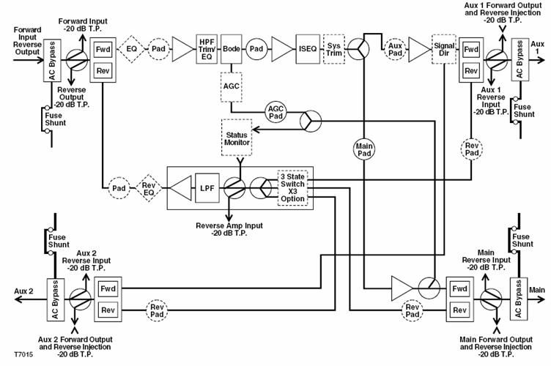
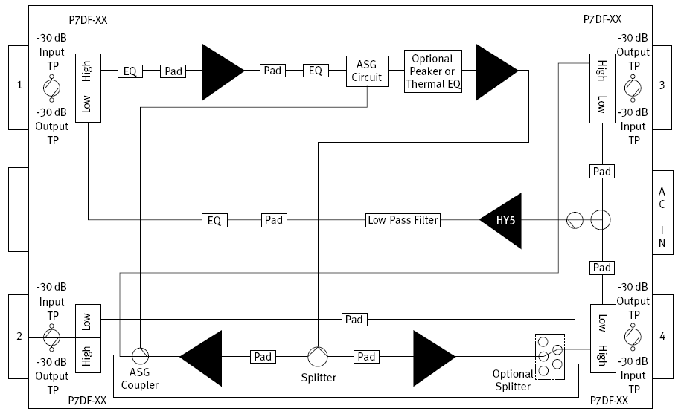
Telemetry Injection
Injections levels may vary due to test point insertion loss differences from various types of equipment.
The PORT Design level is the important Level to remember!
The Port Design level determines the Modem TX Level
-20 dB Forward Test Point
-30 dB Forward Test Point

Slide 10
CATV Return Distribution Network Design -
Modem TX Levels
Values shown are at 30 MHz
Feeder cable: 0.500 PIII, 0.4 dB/100 ft
Drop cable: 6-series, 1.22 dB/100 ft
Amplifier upstream input:
+18 dBmV
+16 dBmV
+20 dBmV
0.6 dB
125 ft
0.8 dB
1.2 dB
1.3 dB
1.9 dB
26
23
125 ft
20
125 ft
17
125 ft
14
125 ft
8
0.5 dB
0.5 dB
0.5 dB
0.5 dB
0.5 dB
125 ft + splitter
125 ft + splitter
125 ft +4 way splitter
125 ft + splitter
125 ft + 4 way splitter
125 ft + splitter
5 dB
5 dB
10 dB
5 dB
10 dB
5 dB
Modem TX:
+49 dBmV
+47dBmV
+47.1 dBmV
+45.1 dBmV
+50.4 dBmV
+48.4 dBmV
+44.1 dBmV
+42.1 dBmV
+47.9 dBmV
+45.9 dBmV
+39.3 dBmV
+51dBmV
+49.1 dBmV
+52.4 dBmV
+46.1 dBmV
+49.9 dBmV
+37.3 dBmV
+41.3 dBmV
The telemetry amplitude is used to establish the modem transmit level.
The modem transmit levels should be engineered in the RF design.
There is no CORRECT answer. IT is SYSTEM SPECIFIC.
Unity gain must be setup from the last amplifier’s return input to the
input of the node port. The same level what ever is chosen or designed
into the system!

Slide 11
Reverse Sweep
Must use consistent port design levels for the return path.
  Sets Modem TX Levels
  Sets the X Level for the network!
Telemetry levels may vary due to insertion losses of test points
  May vary from LE to MB to Node! – PORT LEVEL IS THE KEY!
Must use a good reference
Must pad the return path to match the forward path when internal splitters are used in actives prior to the diplex filters!

Slide 12
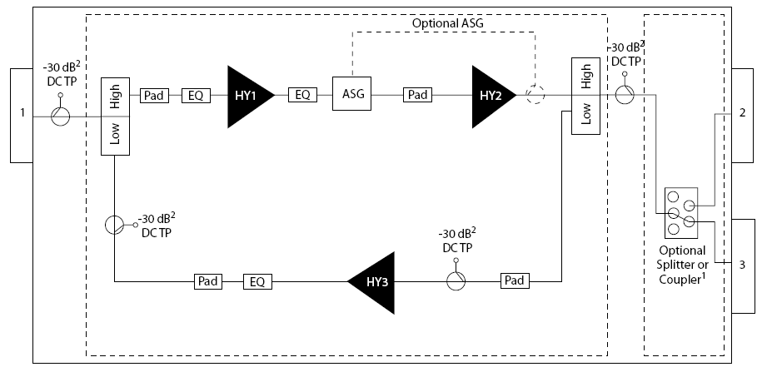
Internal Splitters
An Internal Splitter after
the Diplex Filter effect
the forward and return
levels!

Slide 13
Internal Splitter Prior to Diplex Filter
An Internal Splitter before
the Diplex Filter effects only
the forward levels! The return
levels need to be attenuated
the same as the forward!

Slide 14
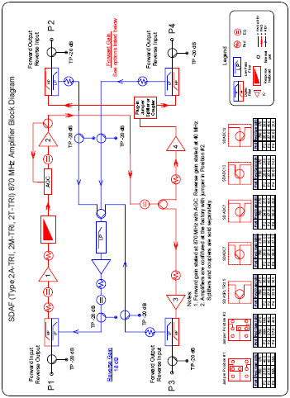
Internal Splitter Prior to Diplex Filter
An Internal Splitter before
the Diplex Filter effects only
the forward levels! The return
levels need to be attenuated
the same as the forward!

Slide 15
Step 3. Adjust reverse output pad to match the reference trace level. Usually at the zero dB reference level.
Step 2. Adjust reverse output EQ for flat response at upstream amp.
Step 1. Inject xx dBmV into the reverse injection test point (main forward output test point) to simulate xx dBmV at the port.

Slide 16
Step 5. Move injection cable to Aux 1 injection port and verify level.
Step 4. Increase the reverse input pad on AUX I and Aux 2 ports to match the loss of a forward plug-in splitter (HGD ONLY) or coupler if used. If a jumper is used the reverse pad would remain a zero or the design value when reverse conditioning is used.
Step 6. Move injection cable to Aux 2 injection port and verify level.

Slide 17
Step 1. Inject xx dBmV into the reverse injection test point (main forward output test point) to simulate xx dBmV at the port.
Step 2. Adjust reverse output EQ for flat response at upstream amp.
Step 3. Adjust reverse output pad to match the reference trace level.

Slide 18
SO FAR SO GOOD?
ANY QUESTIONS?

Slide 19
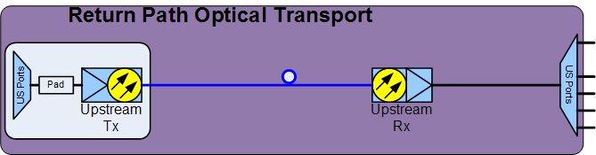
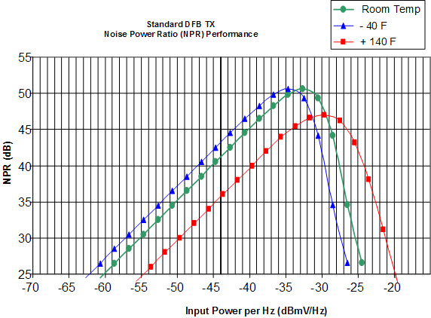
Return Path Optical Transport
Begins at the INPUT to the Node
Ends at the OUTPUT of the return receiver
Can have the greatest effect on the SNR (MER) of the return path
Most misunderstood and incorrectly setup portion of the return path
Must be OPTIMIZED for the current or future channel load.
Is not part of the unity gain of the return path
Must be treated separately and specifically.
Setup Return Laser/Node Specific
Requires cooperation between Field and Headend Personnel

Slide 20
3 Steps to Setting up the Return Path Optical Transport
Have Vendor Determine the Return Path Transmitter “Setup Window” for each node or return laser type in your system
  Must use same setup for all common nodes/transmitters
Set the input level to the Return Transmitter
  Set levels using telemetry and recommended attenuation to the transmitter
  Understand NPR
Return Receiver Setup – It is an INTEGRAL part of the link!
  Using the injected telemetry signal ensure the return receiver is “optimized”

Slide 21
Setting the Transmitter “Window”
In general, RF input levels into a return laser determine the CNR of the return path.
  Higher input – better CNR
  Lower input – worse CNR
Too much level and the laser ‘clips’.
Too little level and the noise performance is inadequate
Must find a balance, or, “set the window” the return laser must operate in
  Not only with one carrier but all the energy that in in the return path.
  The return laser does not see only one or two carriers it ‘sees’ the all of the energy (carriers, noise, ingress, etc.) that in on the return path that is sent to it.

Slide 22
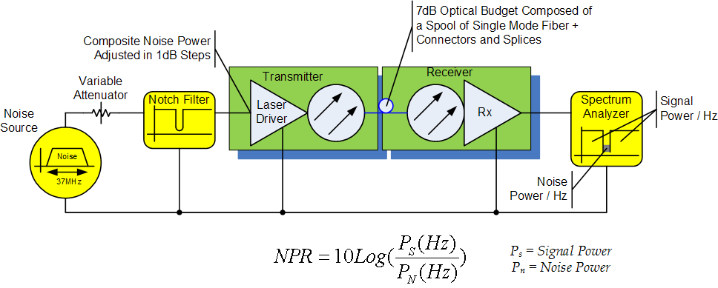
What is NPR?
NPR = Noise Power Ratio
NPR is a means of easily characterizing an optical link’s linearity and noise contribution
NPR and CNR are related; not the same…but close
NPR is measured by a test setup as demonstrated below.

Slide 23
Noise Power Ratio (NPR)
Plot the ratio of signal to noise plus intermodulation (S/{N+I}) versus input level.
Dynamic range at a given signal to noise plus intermodulation (S/{N+I}) defines the immunity to ingress.
Notes:
Noise Power Ratio (NPR)
By varying the input RF level to a transmitter, a noise power ratio (NPR) curve using the noise-in-slot test can be acquired. The noise-in-the-slot test allows us to measure its signal to noise plus intermodulation ratio.
A later slide in this presentation will show a typical NPR curve. This curve typically has the signal to noise plus intermodulation S/(N+I) increasing with increasing RF input level. It will reach a plateau where the S/(N+I) will no longer increase but decrease with increasing RF input level. At this point, the noise and intermodulation effects will start dominating the signal.
For the dynamic range measurement, the noise power ratio curve is used. From the NPR curve, there will be two points meeting a specified performance level on both sides of the curve. The distance between these two points is the transmitter’s input dynamic range in dB.

Slide 24
Noise-In-The-Slot Measurement Test Signal
Plot 10 Log(A/B) vs. Input Level
A
B
5
40
Frequency, MHz
Notes:
Noise-In-The-Slot Measurement Test Signal
This slide illustrates the type of input signal required for performing a noise-in-the-slot test. A white noise signal is bandpass filtered to depict your return path bandwidth, 5 to 40 MHz or 5 to 200 MHz. Typically this signal is filtered for 5 to 40 MHz. (A white noise signal is used to represent data loading.) The test signal is then passed through a notch filter. The resulting signal, as shown in the above slide, gives the measuring points (A/B) for the S/(N+I). This measurement is also called the noise power ratio.

Slide 25
Noise-In-the-Slot Measurement Method
Notes:
Noise-In-The-Slot Measurement Method
This diagram is the noise-in-the-slot test set-up. Note that the notch filter used is 22.5 MHz for a 5-40 MHz return bandwidth. This is where the worst-case intermodulation effects occur. The notch filter should have at least 60 dB suppression. The notched signal is then sent to the device under test (DUT).
The DUT’s output is bandpass filtered and sent to a spectrum analyzer. The spectrum analyzer can measure the levels for noise in the slot (B) and the output power outside the slot (A). This will give a noise power ratio (10 log A/B) value. By varying the input power range of the test signal, a NPR curve is achieved.
Note that the slot will fill up with both noise and intermodulation (second and third order harmonics) with increasing input level.

Slide 26
Noise-In-The-Slot Measurement
50
45
40
35
30
Dynamic Range = 15 dB
S/(N+I), dB
25
20
15
10
-90
-80
-70
-60
-50
-40
RF Input Level, dBmV/Hz
Notes:
Noise-In-The-Slot Measurement Gives NPR
The result of the noise-in-the-slot tests yields a NPR curve.
Suppose that a noise power ratio (S/(N+I)) of greater than 35 dB is required for operation, the input RF level must be between –65 to -50 dBmV/Hz. (Assuming a 35 MHz bandwidth for 5-40 MHz return, the actual input signal power to the transmitter would be 10log(35000000) + -65 dBmV/Hz = 10.4 dBmV) Your dynamic range is defined as approximately 15 dB (= -50 - [-65]). Thus over an input level range of 15 dB, a 35 dB and better NPR performance is achieved.
In practice, return path transmitters are set up closer toward the upward slope portion of the NPR curve. When operated in this region, the transmitter will not suffer a degradation in S/(N+I) in the presence of ingress as long as the total signal is within the transmitter’s dynamic range. If on the other hand, the ingress is sufficiently strong to increase the total input beyond the transmitter’s dynamic range, the S/(N+I) will degrade.

Slide 27
Setting the Return Level
Data (Noise) Loading:
  Best to use dBmV/Hz
Discrete Carrier Loading:
  Best to use dBmV/carrier
Notes:
Setting the Return Level
With data or noise loading, it’s best to use the dBmV/Hz. With discrete carrier loading, these carriers can be easily set by using dBmV/carrier. Thus for a video return, you actually use a dBmV/carrier rather than the dBmV/Hz setup.

Slide 28
Watch Out For…
Forward to return isolation:
  Forward channels on the return
Measuring levels:
  Return is burst digital modulation; average level is much lower than peak level
Notes:
Watch Out For…
Forward and return channels in use causes bleeding and its effect is similar to ingress. It will add to the amount of power that the return path transmitter sees. Thus, forward to return isolation of greater than 40 dB is required. This isolation parameter value is typically part of the node equipment.
In measuring the return levels, the average level is a lot lower than the peak level due to the bursty digital modulation.

Slide 29
Transmitter Technologies (1)
Fabry-Perot Laser:
  Low cost
  High noise (poor Relative Intensity Noise - RIN)
  Higher noise when unmodulated
  Modest temperature stability
  Supports up to 16 QAM modulation
Notes:
Transmitter Technologies (1)
Several return path transmitter technologies and their characteristics will be discussed in the next few slides.
The first transmitter for discussion is the Fabry-Perot laser. This laser has been around for some time, and it’s now a very low-cost laser. It has a high relative intensity noise (RIN) and modest temperature stability. Most Fabry-Perot lasers have no optical isolators. As a result, the lasers are sensitive to optical reflections from either connector interfaces or optical fibers.

Slide 30
Transmitter Technologies (2)
Uncooled DFB Laser:
  Higher cost
  Lower noise (better RIN)
  Modest temperature stability
  Supports up to 64 QAM modulation
Notes:
Transmitter Technologies (2)
The Distributed Feedback (DFB) laser is a newer technology than the Fabry-Perot. This laser has a higher cost, better RIN noise, and lower noise when compared to the Fabry-Perot.
An uncooled DFB laser has modest temperature stability. An uncontrolled temperature environment such as the inside of the node is where temperatures can range from very hot to extremely cold. The range can be from –40ºC to 60ºC.

Slide 31
Transmitter Technologies (3)
Cooled DFB Laser:
  High cost
  Lowest noise (best RIN)
  Good temperature stability
  Supports up to 64 QAM modulation
Notes:
Transmitter Technologies (3)
Temperature controlled DFB lasers are considered ‘cooled’ DFBs. The laser’s temperature is kept stable via a cooler, and not allowed to drift. This cooled DFB laser also provides the lowest noise and best performance. Unfortunately with the addition of the cooler, this type of transmitter has the highest cost.
All three of the previously discussed lasers are still used today. Each meets a specific application requirement.

Slide 32
Transmitter Technologies (4)
Digital Return Laser:
  High cost
  Much less susceptible to optical distortions
  Best temperature stability
  Supports up to 4096 QAM modulation
Notes:
Transmitter Technologies (3)
Temperature controlled DFB lasers are considered ‘cooled’ DFBs. The laser’s temperature is kept stable via a cooler, and not allowed to drift. This cooled DFB laser also provides the lowest noise and best performance. Unfortunately with the addition of the cooler, this type of transmitter has the highest cost.
All three of the previously discussed lasers are still used today. Each meets a specific application requirement.

Slide 33
Transmitter Technologies (4)
Analog
  Lower cost
  Simpler technology.
Digital:
  Highest cost
  Performance is constant for wide range of optical link budgets
  Easy to set up
Notes:
Transmitter Technologies (4)
The fourth type of return path transmitters is digital. Since it’s a fairly new technology, the item has a high cost. Supply and demand will eventually make the relative cost come down.
The performance is constant and independent of link loss over the operating range of the receiver. DFB and FP lasers’ output power and performance are limited to the amount of fiber placed in front of these devices. With a digital laser, performance is constant over a wider range of link budgets.

Slide 34
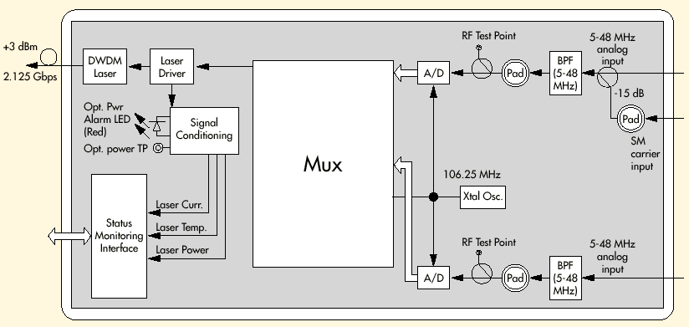
Digital transmitter technology
Notes:
NDT3049 Block Diagram
This slide illustrates the NDT3049 block diagram. Two 5-48 analog inputs get bandpass filtered, and optionally attenuated before the 12 bit A/D converter. The analog streams are sampled at 106.25 MHz. The two digitized streams are time division multiplexed, and the digital signal is sent to the laser driver. The final output optical stream yields a 2.125 Gbps data throughput.
Note the status monitoring for the laser current, temperature, and power.

Slide 35
DFB NPR Curves

Slide 36
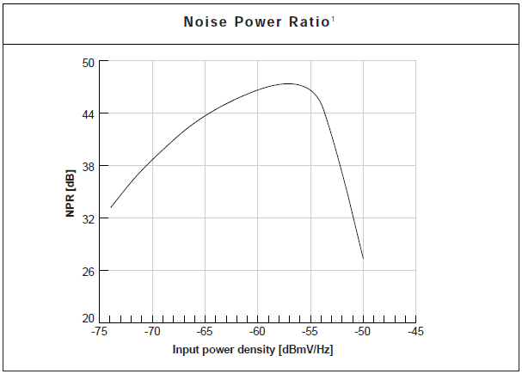
Typical Digital Return NPR Curve
41 dB SNR
-68 dBmV/Hz for 37 MHz bandwidth is +8 dBm total power
Dynamic Range
15 dB

Slide 37
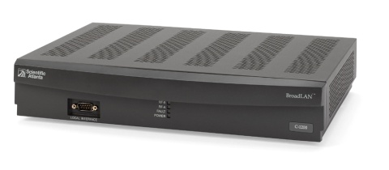
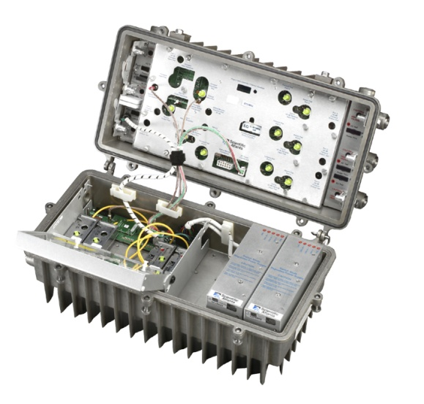
What’s the Big Deal with NPR?
HSD
Business Services
VOD
VOIP

Slide 38
What’s the Big Deal with NPR?
Why do we have to reset our Return Transmitter Input Levels?
  Changes in the signals and number of signals in the return path.
  10 years ago we possibly had one FSK and maybe one QPSK carrier in the return path
  Today we may have as many as four 64-QAM carriers, and two 16-QAM carriers in the return path
  Need to ensure we are not clipping our return transmitters in the node.
Why do the number of channels matter?
What’s the difference between QPSK and 16-QAM?

Slide 39
Per Carrier Power vs. Composite Power
Notes:
Manufacturers of optical transmission equipment generally specify laser input levels in terms of the maximum allowable composite input power. Because of the nature of most signals carried in the upstream spectrum, it is much easier to assign power levels to each signal on a power per Hz basis.
A convenient way to do this is to “divide” the available power into 1 Hz increments using the first formula in the above example. Two things must be known: The total power you are dealing with (for instance, the laser’s maximum input power specification) and the total bandwidth, expressed in Hz.
The second formula allows calculation of each signal’s allocated channel power based on its bandwidth.

Slide 40
Per Carrier Power vs. Composite Power
Notes:
Manufacturers of optical transmission equipment generally specify laser input levels in terms of the maximum allowable composite input power. Because of the nature of most signals carried in the upstream spectrum, it is much easier to assign power levels to each signal on a power per Hz basis.
A convenient way to do this is to “divide” the available power into 1 Hz increments using the first formula in the above example. Two things must be known: The total power you are dealing with (for instance, the laser’s maximum input power specification) and the total bandwidth, expressed in Hz.
The second formula allows calculation of each signal’s allocated channel power based on its bandwidth.

Slide 41
Per Carrier Power vs. Composite Power
As you add more carriers to the return path the composite power to the laser increases.
To maintain a specific amount of composite power into the transmitter the per-carrier power must be reduced.
When channel bandwidth is changed, the channel’s power changes.
  For instance, if a 3.2 MHz-wide signal is changed to 6.4 MHz bandwidth, the channel has 3 dB more power even though the “haystack” appears to be the same height on a spectrum analyzer!
Notes:
Manufacturers of optical transmission equipment generally specify laser input levels in terms of the maximum allowable composite input power. Because of the nature of most signals carried in the upstream spectrum, it is much easier to assign power levels to each signal on a power per Hz basis.
A convenient way to do this is to “divide” the available power into 1 Hz increments using the first formula in the above example. Two things must be known: The total power you are dealing with (for instance, the laser’s maximum input power specification) and the total bandwidth, expressed in Hz.
The second formula allows calculation of each signal’s allocated channel power based on its bandwidth.

Slide 42
Changing Modulation Type – Wider Channel
Note: This example assumes test equipment set to 300 kHz RBW
Notes:
Manufacturers of optical transmission equipment generally specify laser input levels in terms of the maximum allowable composite input power. Because of the nature of most signals carried in the upstream spectrum, it is much easier to assign power levels to each signal on a power per Hz basis.
A convenient way to do this is to “divide” the available power into 1 Hz increments using the first formula in the above example. Two things must be known: The total power you are dealing with (for instance, the laser’s maximum input power specification) and the total bandwidth, expressed in Hz.
The second formula allows calculation of each signal’s allocated channel power based on its bandwidth.

Slide 43
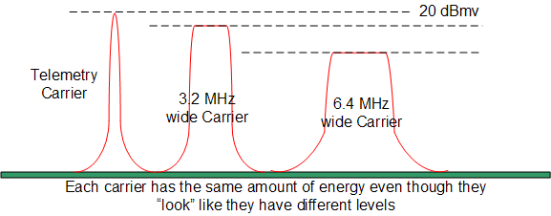
But the Levels Look Different
This is why we cannot use the eMTA to check levels
Your meter will read out low! Apparent amplitude will depend upon the instrument’s resolution bandwidth (IF bandwidth).
Must use the Telemetry for SETUP!
Notes:
Manufacturers of optical transmission equipment generally specify laser input levels in terms of the maximum allowable composite input power. Because of the nature of most signals carried in the upstream spectrum, it is much easier to assign power levels to each signal on a power per Hz basis.
A convenient way to do this is to “divide” the available power into 1 Hz increments using the first formula in the above example. Two things must be known: The total power you are dealing with (for instance, the laser’s maximum input power specification) and the total bandwidth, expressed in Hz.
The second formula allows calculation of each signal’s allocated channel power based on its bandwidth.

Slide 44
Different Modulation Techniques Require Different SNR (MER)
HSD
  16-QAM / 64-QAM (and beyond)
STB (VOD)
  QPSK
Telemetry
  FSK
Business Services
  QPSK to 16-QAM
Modulation Type Required CNR
  Required CNR for various modulation schemes to achieve 1.0E-8 (1x10⁻⁸) BER
    BPSK: 12 dB
    QPSK: 15 dB
    16-QAM: 22 dB
    64-QAM: 28 dB
    256-QAM: 32 dB
Multiple services on the return path with different types of modulation schemes will require allocation of bandwidth and amplitudes.
  Can be engineered.
  Requires differential padding in Headend

Slide 45
BER vs NPR

Slide 46
Why do we care about the drive level to the return transmitter?
The laser performance is determined by the composite energy of all the carriers, AND CRAP in the return path.
What is return path CRAP?
Can it make a difference in return path performance?
How does it effect system performance?
How can you increase your Carrier-to-Crap Ratio (CTC)?

Slide 47
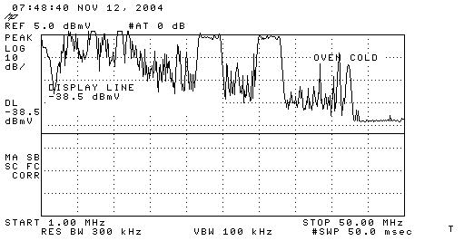
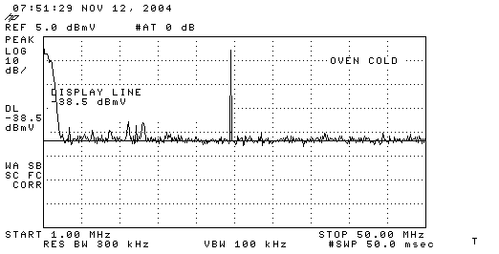
Energy in the Return Path
What does your return path look like?
The return laser ‘sees’ all the energy in the return path.
  The energy is the sum of all the RF power of the carriers, noise, ingress, etc., in the spectrum from about 1 MHz to 42 MHz
  The more RF power that is put into the laser the closer you are to clipping the laser.
  A clean return path allows you to operate your system more effectively.
  The type of return laser you use has an associated window of operation

Slide 48
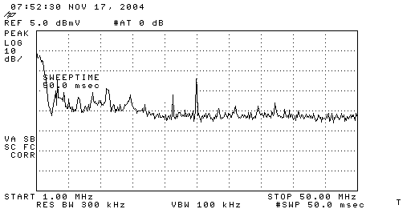
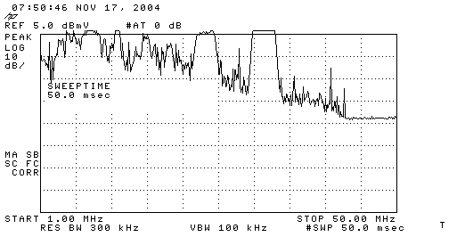
Ingress Changes over Time
Node x Instant
Looks Pretty Good
Node x Overnight
Oh, no!

Slide 49
Return Laser Performance Summary
What Affects Return Path Laser Performance?
Number of Carriers
Carrier Amplitude
Modulation Scheme
Ingress
Will Laser Performance Change over Temperature?
At what temperature should you setup your optical return path transport?
Always follow your manufacture’s setup procedure for the return laser input level!

Slide 50
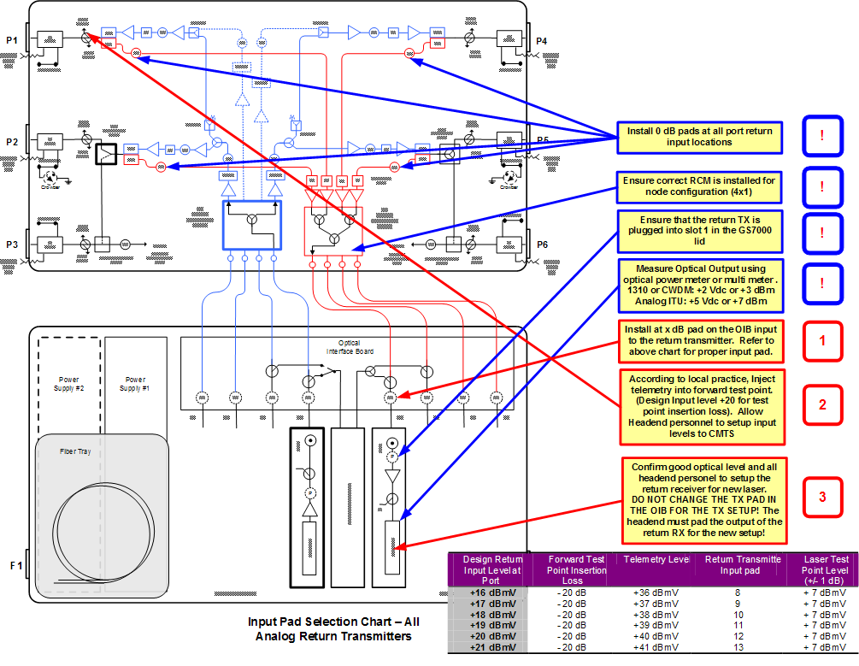
Setting Return Levels in a Non Segmented Node

Slide 51
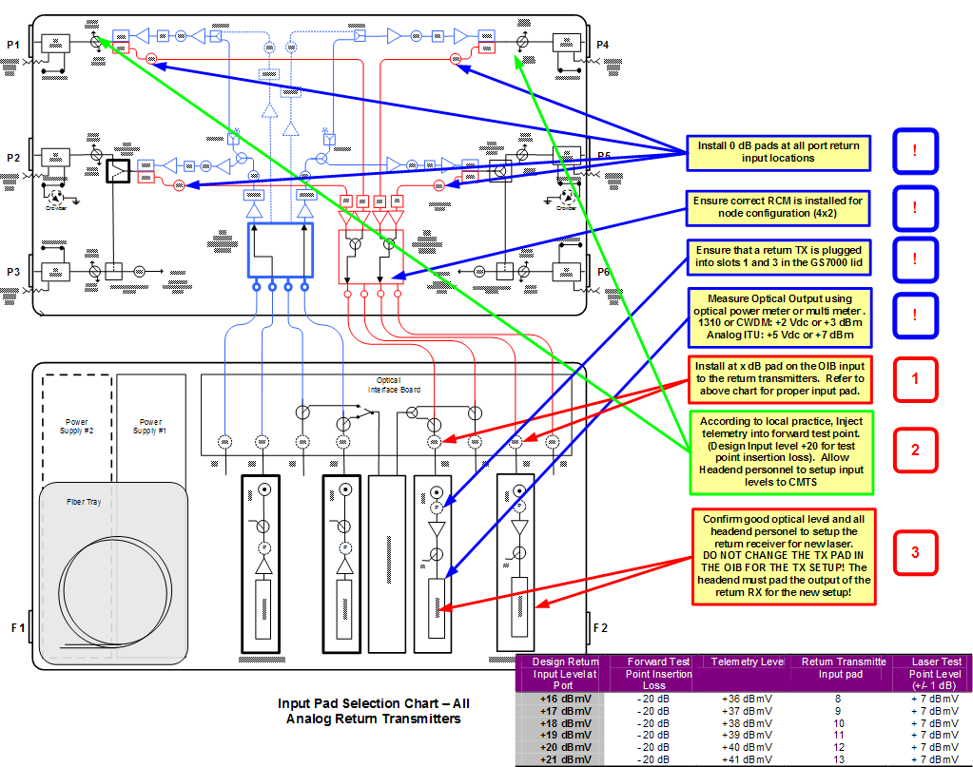
Setting Return Levels in a Half Segmented Node

Slide 52
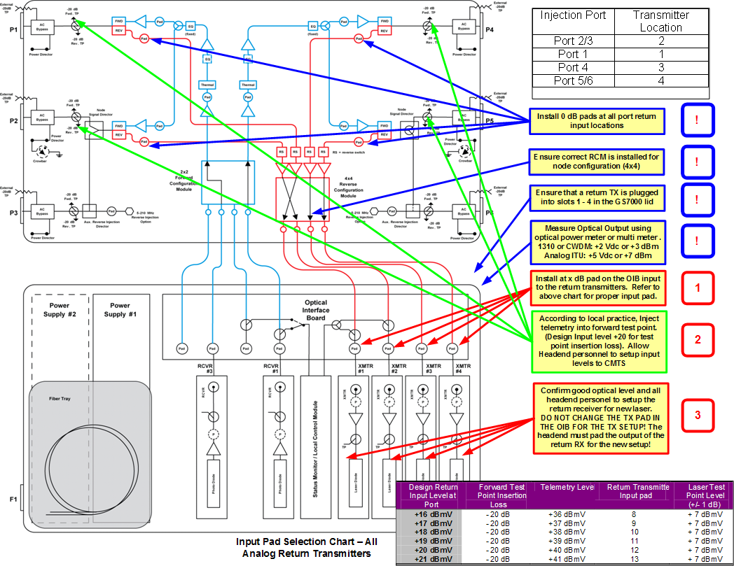
Setting Return Levels in a Fully Segmented Node

Slide 53
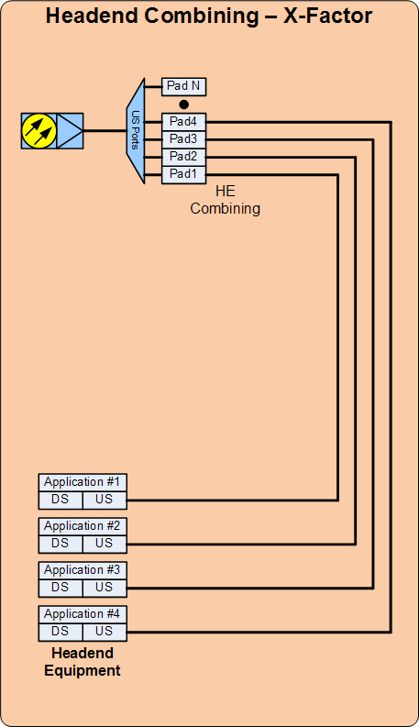
Headend Distribution Network
Begins at the OUTPUT of the optical return path receiver(s)
Ends at the Application Devices
  CMTS, DNCS, DAC, etc.

Slide 54
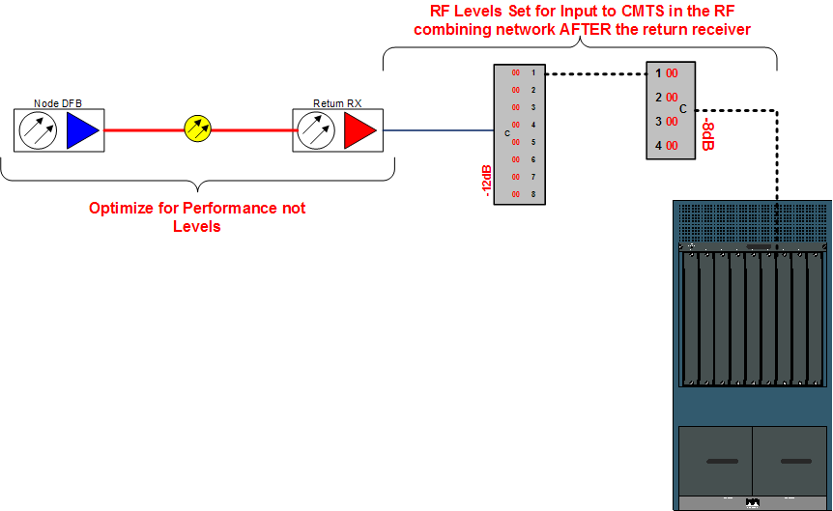
Return Path Headend RF Combining

Slide 55
Headend Optical Return RX Setup
OPTICAL INPUT POWER
Too much optical power can cause intermodulation (clipping) in the receiver
  Follow vendor recommendations for optical input levels; most analog return receivers have a sweet spot range for optimal performance.
  Use optical attenuators on extremely short paths or where too much optical power exists into a receiver
Too little optical power can cause CNR problems with that return path, even if the node’s transmitter is optimized.
  If combined with other return receiver outputs can create noise issues on more paths
For BEST RECEIVER PERFORMANCE, DO NOT optically attenuate optical receivers to the lowest level in the headend (farthest node).
Find the level with which you get the best noise performance out of the receiver.
  Most analog receivers have a sweet spot somewhere in the range of -9 dBm to -6 dBm, but your receiver vendor should recommend!

Slide 56
Headend Optical Return RX Setup
RF OUTPUT LEVELS
On analog transmitter returns from the node
  The less optical power into a receiver the less RF you will have on the output.
  2:1 ratio. For every 1 dB of optical change there is 2 dB of RF (inverse square law)
On Digital transmitter returns from the node
  Optical input power to the receiver has no effect on the RF you will have on the output. RF is created in the D-to-A decoder in the Receiver.
The RF levels on the output of the return receivers should be set PRIMARILY with external RF attenuation between the Return RX and the first RF splitter.

Slide 57
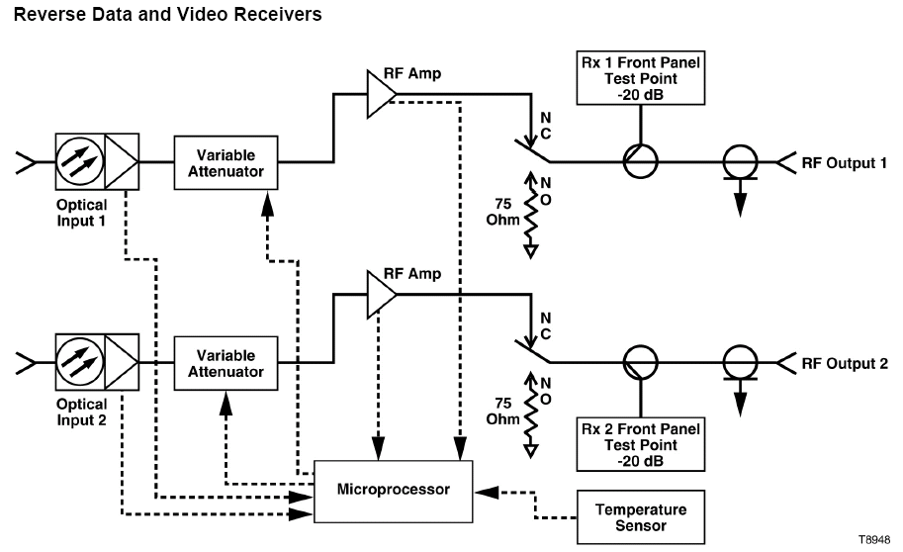
Example – Analog Return Path Receiver

Slide 58
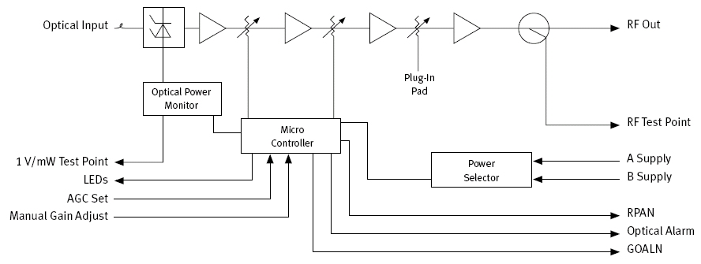
ELLRR Schematic

Slide 59
Return RX Setup
Rules of Thumb (company specific):
  Do not optically attenuate the return path so all the optical inputs are the same as the lowest.
  The lower the optical input power, the lower the CNR of the receiver.
  Attenuate RF externally to the device
Must have enough level so that the CMTS or other devices receiving the signals from the return path operate acceptably.
  There can be excessive passive loss from the output of the optical receiver to the terminating device.
    8-way splitter/combiner – 10.2 dB typical
    4-way splitter/combiner – 6.8 dB typical
  Typical input into terminating device.
    CMTS: 0 dBmV
    DNCS: -3 to +27 dBmV

Slide 60
Return Path Headend RF Combining
The RF pad at the node TX sets the PERFORMANCE!
The RF pads at the HE or Hub set the LEVEL!

Slide 61
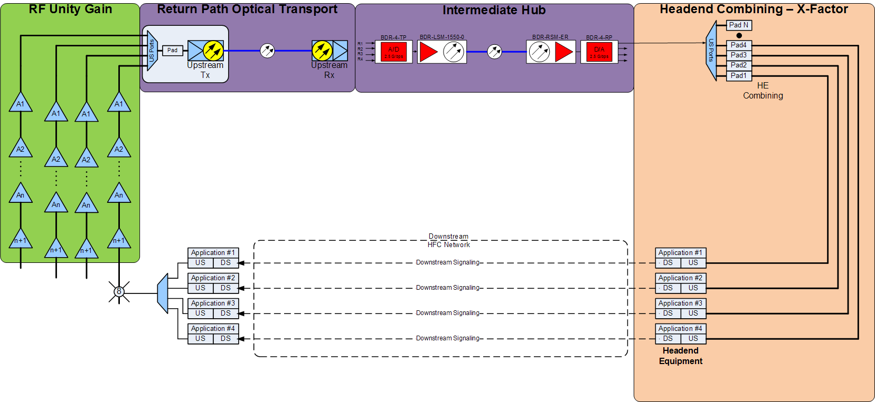
Intermediate Hub Setup
Must optimize each section separately
Must continue to use telemetry!

Slide 62
Hub-Based Digital DWDM Return
Hub
Node
Headend or

Slide 63

The X LEVEL!

Slide 64
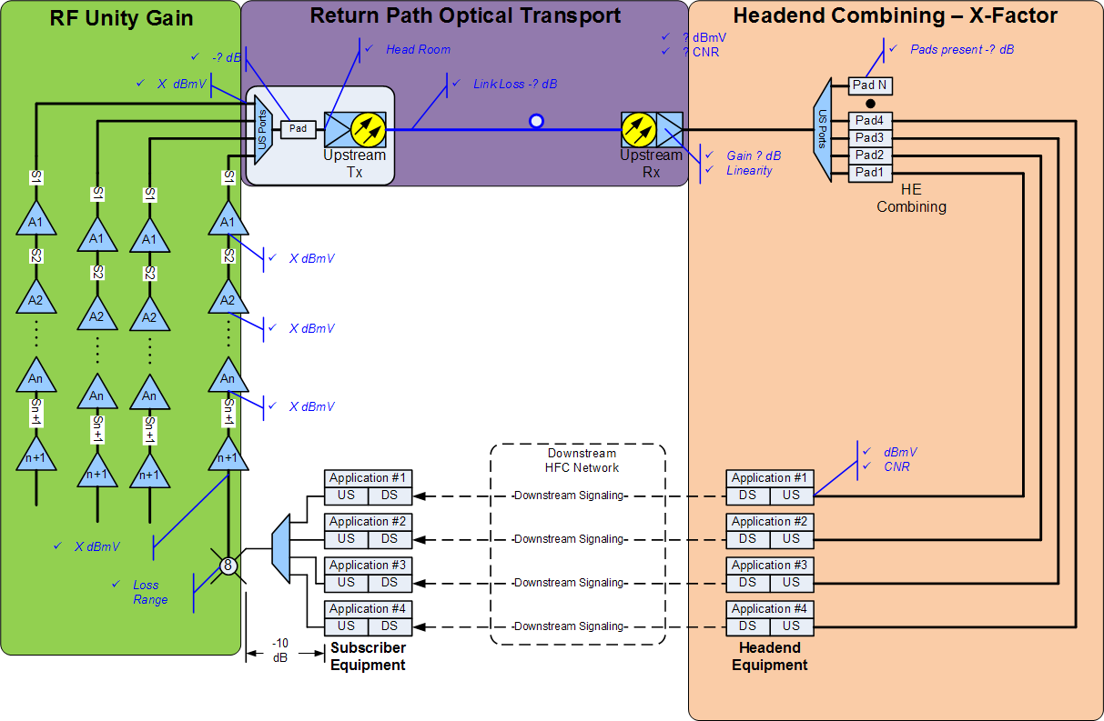
X Level
Notes:
The easiest way to set upstream signal levels is to establish what is called the X level. This is a headend upstream signal level that is the result of providing the proper level at the input to the last reverse amplifier (the first amplifier or node out of the headend).
To establish the X level, go to the first downstream amplifier or node location out of the headend. Here you should inject a signal into that location’s reverse amplifier module input at a level known to be correct. This will result in a signal at the headend that is measured and defined as the X level.
Assuming your system was designed for unity gain operation, when you go to the next amplifier location and inject the proper amplitude test signal there, the resulting signal at the headend will be the same as the original X level. If it is not, you can make necessary adjustments and install the proper output attenuator and equalizer to achieve the correct upstream input level at the first amplifier location, which will give you the desired headend X level.

Slide 65
Setting up the Return Path
Finding the “X” Level
Determining the Return Transmitter “Window”
Padding the Transmitter
Return Receiver Setup
Distribution out of the Return Receiver
Padding the inputs to the Headend Equipment

Slide 66
Setting Upstream Signal Levels
X level
The easiest way to set upstream signal levels is to establish what is called the X level.
  This is a headend upstream signal level that is the result of providing the proper level at the input to the last reverse amplifier (the first amplifier or node out of the headend).
To establish the X level, go to the first downstream amplifier or node location out of the headend.
  Here you should inject a signal into that location’s reverse amplifier module input at a level known to be correct.
  This will result in a signal at the headend that is measured and defined as the X level.
Assuming your system was designed for unity gain operation, when you go to the next amplifier location and inject the proper amplitude test signal there, the resulting signal at the headend will be the same as the original X level.
  If it is not, you can make necessary adjustments and install the proper output attenuator and equalizer to achieve the correct upstream input level at the first amplifier location, which will give you the desired headend X level.
Notes:
Setting upstream signal levels is best done by using a procedure based on what is called the X level. Before setting levels, you need to understand internal signal flow and losses for the amplifiers used in your system. The equipment manufacturer can provide copies of block diagrams with this information. In many cases, equipment manufacturers also may be able to provide detailed upstream alignment instructions for the particular equipment in use.

Slide 67
Changes to the Return Network
ANY CHANGES TO THE RETURN PATH FROM THE SUBSCRIBER TO THE HEADEND CAN EFFECT ITS PERFORMANCE
Planned
  Segmentation of Return
    Changes in Headend or Node
Un-Planned
  Bad tap
  Optoelectronics Failure
  Ingress
  Technician – Laser RF input level changes in the field

Slide 68
ANY CHANGES TO THE RETURN PATH FROM THE SUBSCRIBER TO THE HEADEND CAN AFFECT ITS PERFORMANCE
Notes:
The easiest way to set upstream signal levels is to establish what is called the X level. This is a headend upstream signal level that is the result of providing the proper level at the input to the last reverse amplifier (the first amplifier or node out of the headend).
To establish the X level, go to the first downstream amplifier or node location out of the headend. Here you should inject a signal into that location’s reverse amplifier module input at a level known to be correct. This will result in a signal at the headend that is measured and defined as the X level.
Assuming your system was designed for unity gain operation, when you go to the next amplifier location and inject the proper amplitude test signal there, the resulting signal at the headend will be the same as the original X level. If it is not, you can make necessary adjustments and install the proper output attenuator and equalizer to achieve the correct upstream input level at the first amplifier location, which will give you the desired headend X level.

Slide 69
ANY CHANGES TO THE RETURN PATH FROM THE SUBSCRIBER TO THE HEADEND CAN AFFECT ITS PERFORMANCE

Slide 70
Return Path Maintenance and Troubleshooting

Slide 71
Upstream Challenges
Problems with sub-split in two-way networks:
  Upstream noise funneling
  Prevalence of manmade noise in upstream frequency spectrum
  Lack of upstream reference signals
  Difficult to locate problems
Notes:
When one thinks of RF problems that may affect CMTS or cable modem operation, the first thought that comes to mind is almost always upstream performance. Upstream RF problems are seemingly ubiquitous in many cable networks.
Most cable systems use a sub-split band plan for signal transmission. Downstream signals, that is, signals sent from the headend to the subscriber, generally occupy the 50-860 MHz spectrum. Upstream signals, those sent from the subscriber to the headend, are carried in the 5-42 MHz spectrum.
There are several potential problems with sub-split two-way operation. They include the effects of upstream noise funneling, where signals and potential interference from many points “funnel together” to one point: the headend. To make matters worse, interference from just one location can disrupt upstream signals from the entire cable network. Other problems include the prevalence of manmade noise in the upstream spectrum, such as short-wave broadcasts, amateur (“ham”) radio, citizens band (CB) and other two-way radio transmissions, and electrical interference.
Unlike the downstream, the upstream generally has no continuous reference carriers for setting levels. Much of the upstream traffic is digitally modulated carriers, which require different measurement techniques than traditional analog TV channels. Some of the digital signals may be bursty in nature, making them even more difficult to capture and measure.
When a problem such as ingress occurs, it can be very difficult to isolate and troubleshoot. This is because ingress can be coming from one or more of potentially hundreds or even thousands of points in the network. An estimated 95% of ingress and other problems affecting the upstream path originate in subscriber drops. 25% of the problems happen between the tap and the side of the subscriber’s house (exterior drop wiring), 70% occur between the side of the house and the TV set (interior wiring), and only 5% are network-related.

Slide 72
Upstream RF Impairments
Stationary Impairments
Thermal noise
Intermodulation distortion
Frequency response
Transient Impairments
RF ingress
Impulse noise
Signal clipping
Multiplicative Impairments
Intermittent connections
Group Delay
Notes:
The first category of upstream impairments is known as stationary impairments. These include such things as thermal noise, intermodulation distortion, frequency response problems, transit delay and group delay.

Slide 73
Thermal Noise
Characteristic of all active components:
  Optoelectronics
  Upstream amplifiers
  In-home devices
Improper network alignment or defective equipment can cause low carrier levels or a high noise floor—as can improper upstream combining—which will degrade carrier-to-noise ratio
Notes:
Thermal noise is generated in all active components, and to a lesser degree in passive components. Besides choosing equipment with a relatively low noise figure, there is little else that a cable operator can do about the thermal noise generated in active devices, other than ensure proper network alignment and to make sure that upstream combining follows good engineering practice.
The major sources of thermal noise in the upstream network include optical electronics (lasers and receivers), amplifiers, and in-home devices such as set top boxes and cable modems.
Improper network alignment has been found to be a major cause of excessive thermal noise. Excessive thermal noise also may occur when too many nodes, upstream amplifiers, etc., are combined at the headend.

Slide 74
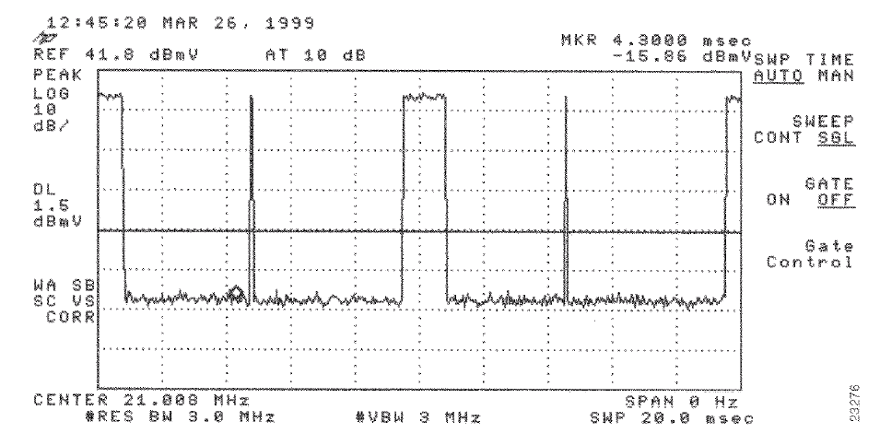
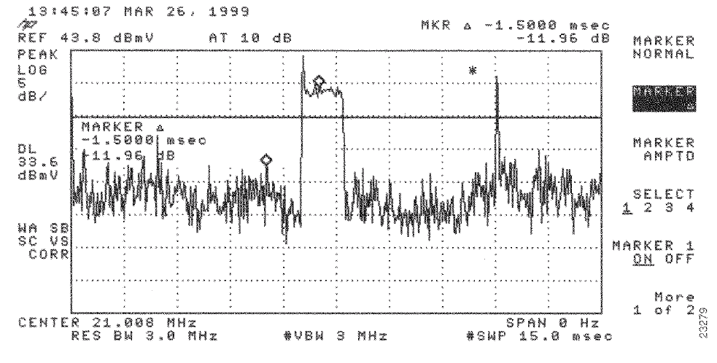
Thermal Noise
Good carrier-to-noise
ratio (~50 dB)
Poor carrier-to-noise
ratio (~12 to 15 dB)
Notes:
Keep in mind that DOCSIS specifies 25 dB minimum carrier-to-noise ratio at the CMTS upstream input, regardless of modulation format.
One major North American multiple system operator (MSO) that provides cable modem service and primary line telephony service to its customers has an internal company specification of 40 dB carrier-to-noise ratio over the 20 MHz to 40 MHz spectrum.

Slide 75
Intermodulation Distortion
Second and third order distortions most prevalent
Active devices
Passive components
  common path distortion
  passive device intermodulation
2nd order beats
3rd order beats
Large 2nd order beats spaced every 6 MHz, and smaller 3rd order beats +/-1.25 MHz from 2nd order beats
Notes:
The most common types of intermodulation distortion affecting the upstream path is second and third order distortions. These are generated in active devices such as upstream amplifiers (especially single-ended type amplifiers) and upstream fiber links.
A more troubling type of intermodulation distortion can occur in passive components. It is known as common path distortion, and usually occurs at a dissimilar metals interface. The dissimilar metals interface acts like a diode, and downstream signals passing through the diode-like junction generate second and third order beats that appear every 6 MHz in the upstream spectrum (the distortions are spaced 8 MHz apart in PAL systems).
Passive device intermodulation can occur in drop passives—for instance, splitters—when residual magnetism is present in the devices’ toroidal transformer ferrites, and high amplitude upstream RF signals from inside the home saturate the ferrites. This problem can be avoided by using drop passives that incorporate specialty ferrite mixes in the toroidal transformers, along with DC blocking capacitors and splitter circuit redesign.

Slide 76
Frequency Response
Amplifier alignment
  Input and output levels
  Proper pads and equalizers
Alignment-related problems
  Frequency response problems can cause group delay errors
  Misalignment can cause increase in noise and distortions
Notes:
Most frequency response problems are caused by improper network alignment, as well as defective or missing ends-of-line, tap port and splitter and directional coupler port terminations. It’s very important that cable operators pay close attention to network alignment in both the downstream and upstream signal paths.
The best way to align the cable network—including the upstream—is with broadband sweep equipment. Some operators use two-carrier or four-carrier signal generators for upstream maintenance, which is useful for initial rough alignment. The use of multiple carriers does not provide adequate resolution to properly align the amplifiers or to see frequency response in between the carriers.
When the upstream frequency response and alignment has not been done properly, the result can be excessive noise, distortions, frequency response problems, and group delay errors.

Slide 77
Frequency Response
Defective coaxial cable caused frequency response problem
Notes:
This frequency response problem was caused by a defective span of .750 cable. The defective cable was replaced and the problem disappeared. Interestingly, the downstream frequency response was acceptable. The problem affected only the upstream frequency response. Sweep test equipment is necessary to identify this kind of impairment, because a two- or four-carrier signal generator measurement method would not have sufficient resolution.

Slide 78
RF Ingress
Upstream spectrum is shared with over-the-air users
  Short-wave broadcasts
  Citizens band (“CB”) radio
  Amateur (“ham”) radio
  Ship and aeronautical communications
  Government communications
Over-the-air RF signals can enter network through cable shielding defect
Bad TVs, VCRs or other in-home devices
Notes:
The upstream spectrum used by cable operators is shared with numerous over-the-air users. Signals in the over-the-air environment include high powered short-wave broadcasts, amateur (“ham”) radio and other two-way radio communications, and government communications.
If the cable, active or passive device shielding is not adequate, or has been compromised for some reason, over-the-air signals can enter the CATV network and interfere with upstream signals.
Several cable operators have found that maintaining downstream signal leakage at or below 5 microvolts per meter in both the network and drops eliminates most upstream ingress problems!

Slide 79
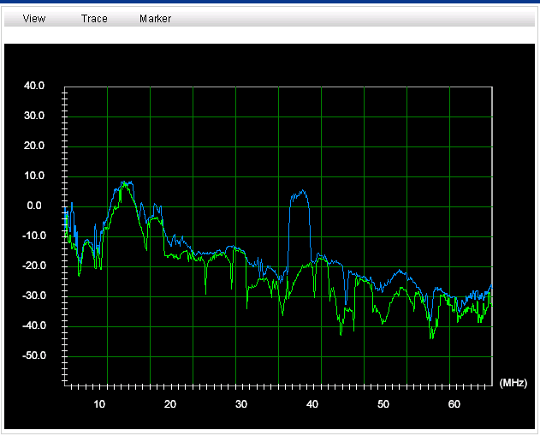
One Bad TV takes out a Node

Slide 80
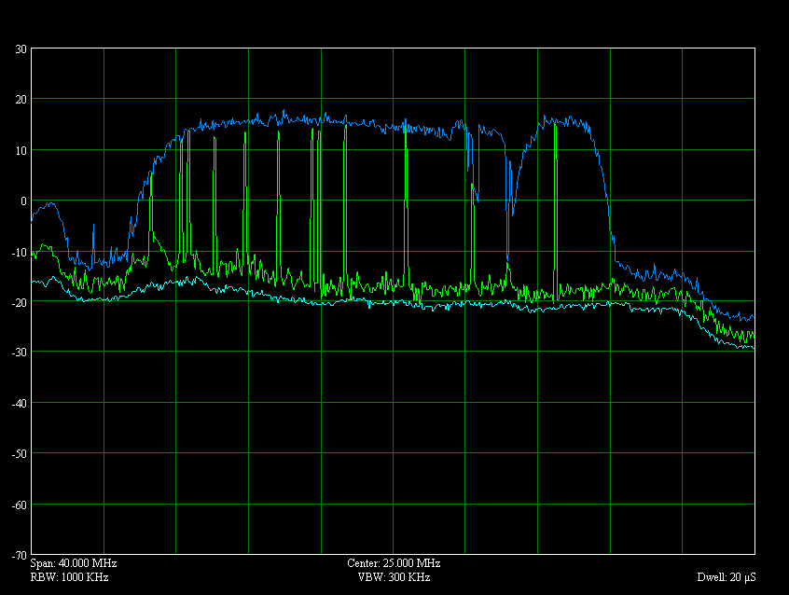
AT&T in the Return Path!

Slide 81
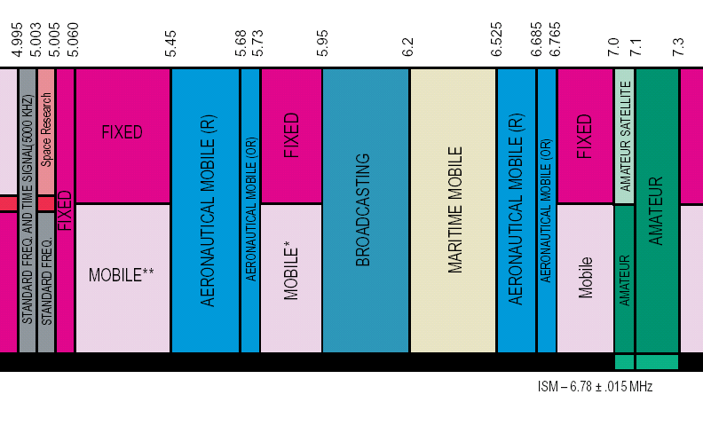
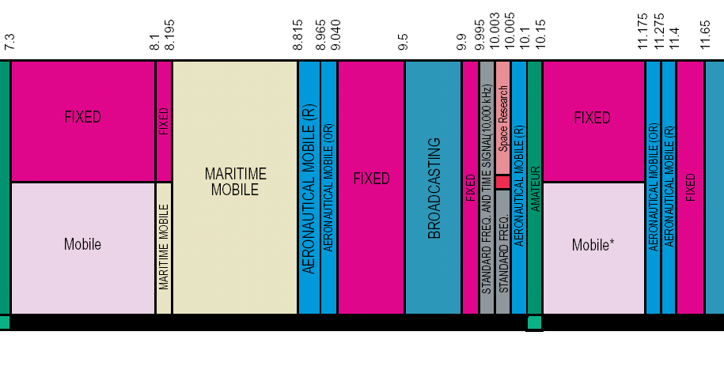
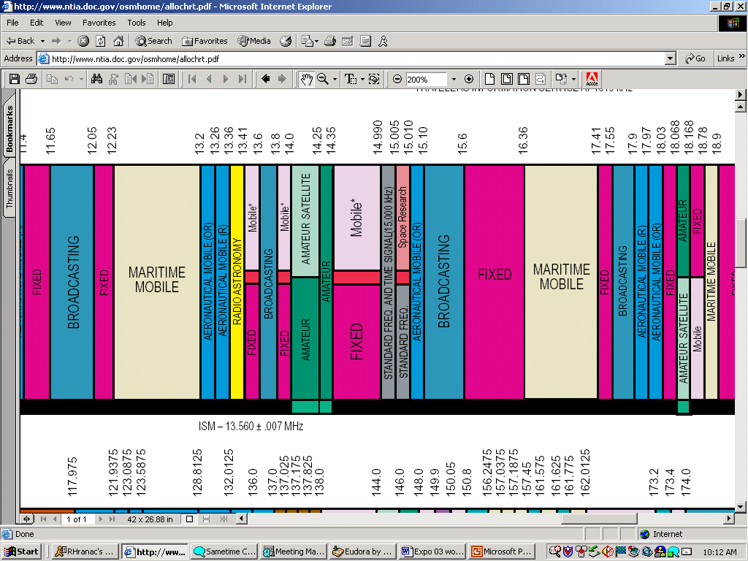
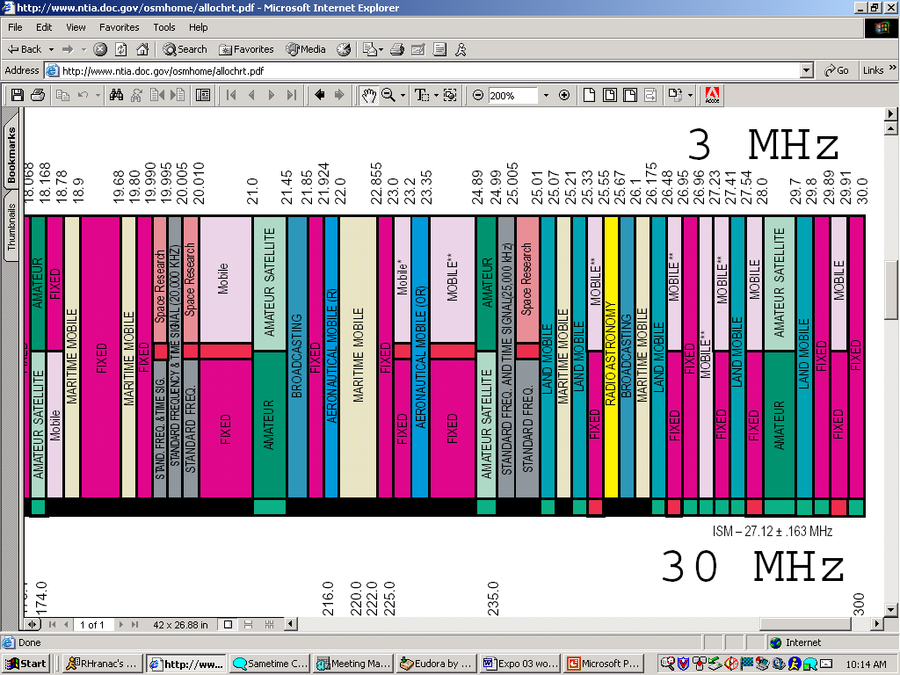
Upstream Over-The-Air Spectrum, 5-30 MHz
Source: NTIA (http://www.ntia.doc.gov/osmhome/allochrt.pdf)

Slide 82
RF Ingress
CB radio operator had installed his own cable outlets (note the +40 dBmV signal at ~27 MHz—this was at the node!)
Notes:
This high level of interference was caused by a CB radio. The CB operator (also a cable subscriber) had installed several of his own outlets, which were susceptible to ingress from his CB radio. The cable operator identified the problem by monitoring for downstream signal leakage, contacted the subscriber, and replaced the subscriber-installed internal wiring with better quality cable and components.

Slide 83
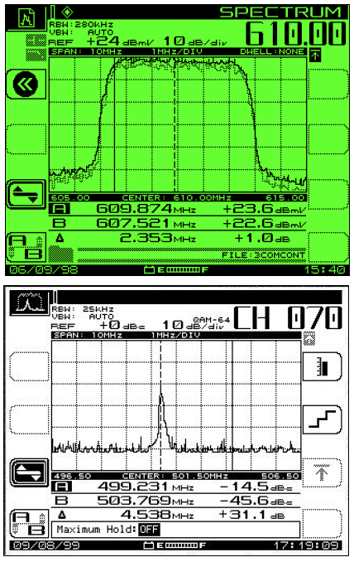
Ingress under the Carrier
Interference will cause poor MER
  CTB
  CSO
  Ingress
  Spurious

Slide 84
Impulse Noise
Most upstream data transmission errors caused by bursts of impulse noise
  Fast rise time, short duration
  <100 microseconds
  Most less than 10 microseconds duration
Significant energy content over most of upstream spectrum
Common sources
  Vehicle ignitions, neon signs, lightning, power line switching transients, electric motors, electronic switches, household appliances
Notes:
Most upstream data transmission errors have been found to be caused by bursts of impulse noise. Impulse noise is characterized by its fast rise time and short duration. Impulse noise is generally less than 100 microseconds duration, although most has been found to be below 10 microseconds.
The short duration, fast rise time characteristics of impulse noise also means that it contains significant broadband energy, often throughout the entire upstream signal spectrum.
Common sources of impulse noise include vehicle ignitions, neon signs, static from lightning, power line switching transients, electric motors, electronic switches (thyristors are especially bad), and household appliances such as hair dryers, thermostats, garbage disposals, aquarium heaters, and electric blankets.

Slide 85
Impulse Noise
Impulse noise from arc welder in machine shop
Notes:
This is an example of upstream impulse noise interference generated by an arc welder in a small machine shop that had cable service installed in the company’s business office. No significant signal leakage was detected in the vicinity of the drop, but installation of a high pass filter at the tap cleared up the problem. (Note: The four carriers are system reference carriers generated by the cable company’s own test equipment. The impulse noise appears between the carriers, and is especially bad between the third and fourth carriers.)

Slide 86
Intermittent Connections
Self-induced
  Network maintenance: changing pads & equalizers, amplifier modules
Craft-related
  Loose or damaged connectors
  Poor quality installation
Notes:
Intermittent connections have been found to disrupt upstream data transmission. Intermittent connections can be self-induced. For example, when a cable technician changes reverse amplifier pads and equalizers, or changes reverse amplifier modules, the brief interruption will disrupt the upstream signal path.
Other causes of intermittent connections are usually craft-related, and are caused by loose or damaged connectors, and poor quality workmanship.

Slide 87
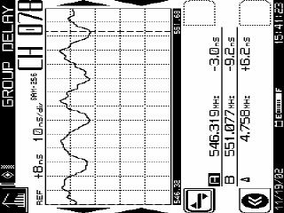
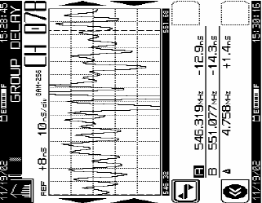
Group Delay
Group delay is the measure of the slope of the phase shift with frequency.
Effects: If there are group delay variations in the network, then signals of one frequency can make it through the network faster than signals at another frequency.
For digital signals the effect can lead to QAM symbol misinterpretation.
The net effect is that short duration pulses that are input into the network will exit the network having a longer duration.
This spreading leaves energy from one pulse in the time slot of other pulses.
This causes the BER to degrade.

Slide 88
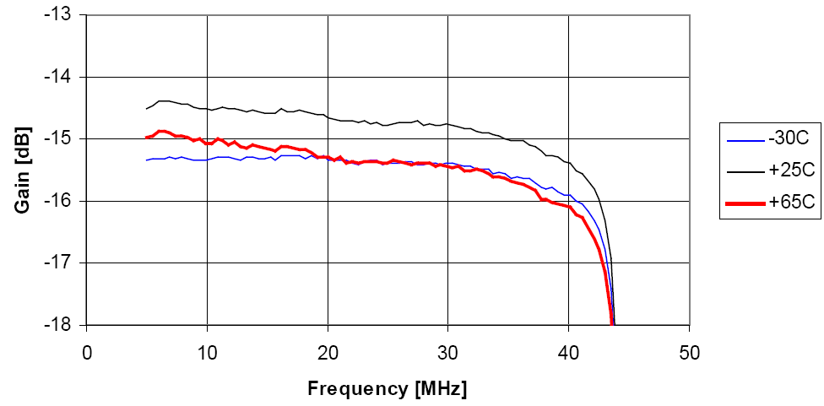
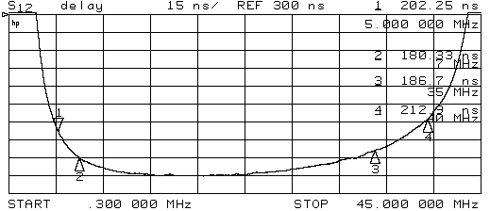
Group Delay
Amplitude (dB)
Frequency Response:
What we see on our sweep gear
Time (nanoseconds)
Group Delay:
What we don’t see on our sweep gear
Notes:
Intermittent connections have been found to disrupt upstream data transmission. Intermittent connections can be self-induced. For example, when a cable technician changes reverse amplifier pads and equalizers, or changes reverse amplifier modules, the brief interruption will disrupt the upstream signal path.
Other causes of intermittent connections are usually craft-related, and are caused by loose or damaged connectors, and poor quality workmanship.

Slide 89
Signal Clipping
RF ingress and impulse noise may cause signal clipping
  Can affect composite power into return laser
Excessive signals from in-home devices such as pay-per-view STBs also may cause signal clipping
Clipping occurs in upstream amplifiers and fiber optics equipment
  FP upstream lasers generally more susceptible than DFB lasers
Energy that can cause clipping found mostly from 5 MHz to 15 MHz range
Signals at all other frequencies are affected by cross-compression
  Cross-compression affects all upstream frequencies
  Can reduce data throughput (TCP/IP controlled resend)
Notes:
RF ingress and impulse noise may cause signal clipping in active devices such as upstream amplifiers and lasers. Excessive signal levels from in-home devices such as pay-per-view set top boxes may cause signal clipping, too.
Signal clipping, also known as compression, occurs in upstream amplifiers and fiber optics equipment. Upstream lasers are very susceptible to clipping.

Slide 90
Signal Clipping
To avoid clipping, set up return laser operational window to recommended level
Do not adjust levels at the node once setup is accomplished
  Don’t change the pad to get more RF level in the Headend.
  Don’t change the pad to get better CNR at the return RX.
Set it, Leave it, Love it.
Notes:
RF ingress and impulse noise may cause signal clipping in active devices such as upstream amplifiers and lasers. Excessive signal levels from in-home devices such as pay-per-view set top boxes may cause signal clipping, too.
Signal clipping, also known as compression, occurs in upstream amplifiers and fiber optics equipment. Upstream lasers are very susceptible to clipping.

Slide 91
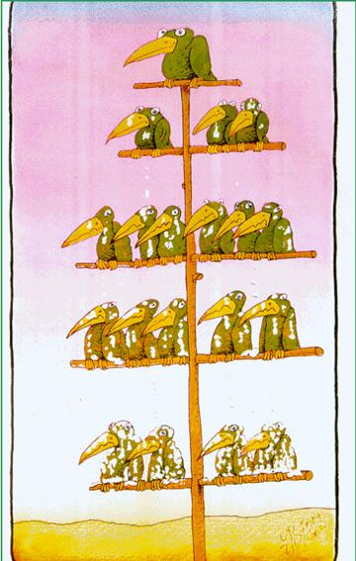
Conclusions
Return system is a loop
Changes anywhere in the loop can effect the performance of the network
Once the return laser is setup DON’T TOUCH IT
  Changing the drive levels can affect the window of operation of the laser
Work as a team to diagnose system problems
  XOC
  Market Health, Scout, Score Card, Watchtower
Avoid performing node setups during extremes in outdoor temperatures

Slide 92
Questions

